Slide 1
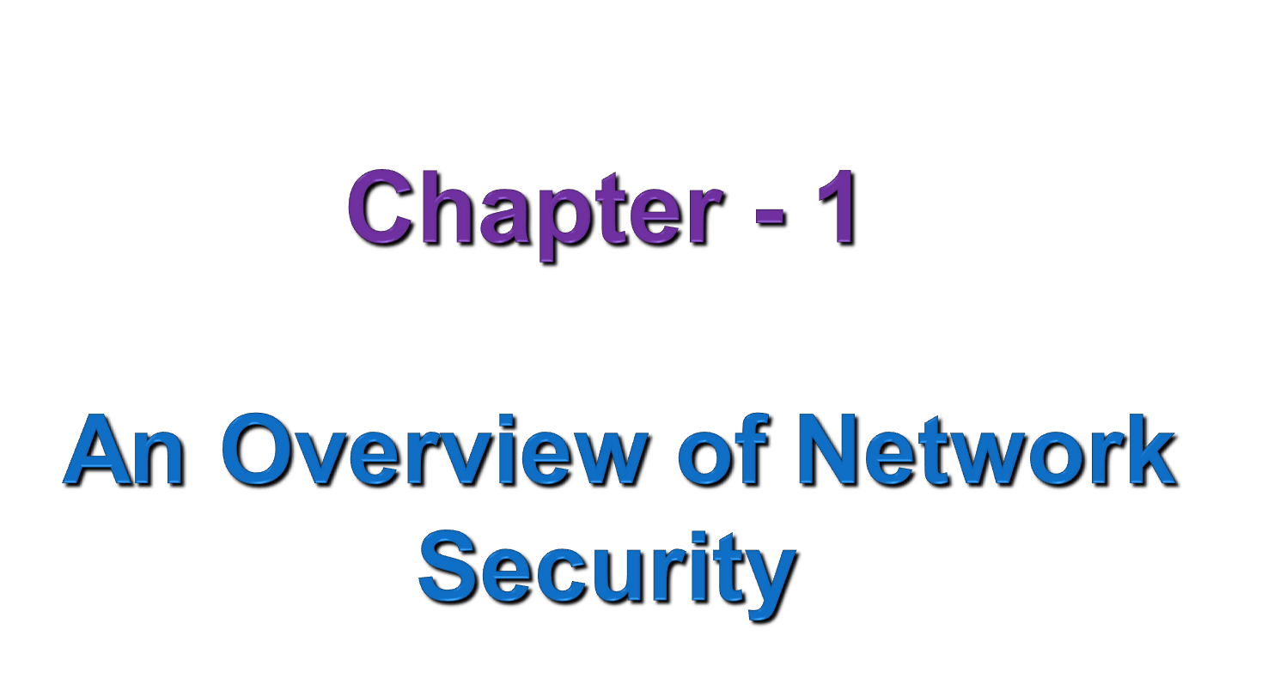
Notes:
SCA3103 - Introduction to Multimedia
Semester 2 - 02/03
Lecture 1

Slide 2
Outline
Network Security concept
Importance of Computer Security
Security Attacks and level of practical attacks
Attacker profiles
Security Services and its importance
Security Mechanisms
Basic Model for Network Security

Slide 3





Let me send Alice those files
I can’t access the network.
Oh My!
Steve
Non secure network
Bob
Alice
Mike
Crypt
William the

Slide 4
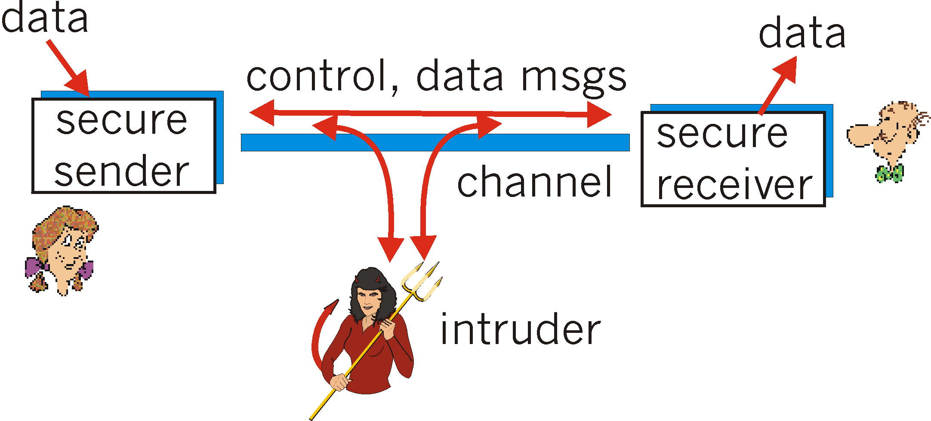
The Problem
Bob
Alice

Slide 5
1.1 Network Security Concept
If you know your enemies and know yourself, you will win hundred times in hundred battles. If you know yourself but not your enemies, you will suffer a defeat for every victory won. If you do not know yourself or your enemies, you will always lose.
Sun Tzu, "The Art of War“
The art of war teaches us not on the likelihood of the enemy’s not coming, but on our own readiness to receive him; not on the chance of his not attacking, but rather on the fact that we have made our position unassailable.
The art of War, Sun Tzu

Slide 6
Cont...
Computer system security consists of measures to deter, prevent, detect, and correct security violations in information system.
Information Systems are decomposed in three main portions, hardware, software and communications.
Information Security requirements have changed in recent times
      traditionally provided by physical (locking) and administrative mechanisms (Personal screening during hiring).
Computer use requires automated tools to protect files and other stored information b/c of introduction of distributed systems and use of networks and communications facilities for carrying data between terminal user and computer.

Slide 7
Cont...
The Various Computer System Securities:-
Data security:-
  Means of ensuring that data is kept safe from corruption and that access to it is suitably controlled.
Computer Security:-
  Deals with protection of information and property from theft, corruption, or natural disaster, while allowing the information and property to remain accessible and productive to its intended users.
  Generic name for the collection of tools designed to protect data and to thwart hackers.

Slide 8
Cont...
  Malware: malicious software which includes computer viruses, worms, trojan horses, most rootkits, spyware, dishonest adware.
Network Security:
  Measures to protect data during their transmission.
  Providing protection at the boundaries of an organization
  Starts from authenticating any user, most likely a username and a password
Internet Security:
  Measures to protect data during their transmission over collection of interconnected networks

Slide 9
Why Computer Security?
To give people the freedom to enjoy computer and computer networks without fear of compromising their rights and interests.
    Enabling people to carry out their jobs, education/research
    Supporting critical business process
    Protecting personal and sensitive information
Computer security is therefore needs to guard computer system and networked systems as well as protect electronic data that is either stored on computers or transmitted over the networks.
This means that everyone who uses a computer or mobile device needs to understand how to keep their computer, device and data secure.
  Information Technology Security is everyone's responsibility!

Slide 10
Cont . . .
Computer Security System:
  The protection afforded to an automated information system/data in order to attain the applicable objectives of preserving the integrity, availability, and confidentiality of information system resources (includes hardware, software, firmware, information/ data, and telecommunications).
Therefore this course enables you
  To Learn "good computing security practices."
  To Incorporate these practices into your everyday routine. Encourage others to do so as well.
  To Report anything unusual to your supervisor and ITS Support Center if you become aware of a suspected security incident

Slide 11
Consequences
The consequences of ignoring computer security includes the following
      Loss Of Confidential Data
      Loss In Productivity
      Identity Theft
      Compromised Data Integrity
      Unavailability Of Access To Data Or Computer Network
      Lawsuits & Judicial Actions
      Termination Of Employment

Slide 12
1.2 Security Threats and Attacks
What is Computer security Threats?
A threat is a possible danger that might exploit a vulnerability to breach security and thus cause possible harm.
A threat can be either
    "intentional" (i.e., intelligent; e.g., an individual cracker or a criminal organization) or
    "accidental" (e.g., the possibility of a computer malfunctioning, or the possibility of a natural disaster such as an earthquake, a fire, or a tornado) or
    otherwise a circumstance, capability, action, or event

Slide 13
History of computer security threats
1986 The first virus for PCs - The first virus for IBM PCs, Brain, was written by two brothers in Pakistan, when they noticed that people were copying their software. The virus put a copy of itself and a copyright message on any floppy disk copies their customers made.
1971 The first worm - Bob Thomas, a developer working on ARPANET, a precursor to the Internet, wrote a program called Creeper that passed from computer to computer, displaying a message.
1988 The Internet Worm - Robert Morris, a 23-year-old student, released a worm on the US DARPA Internet. It spread to thousands of computers and, due to an error, kept re-infecting computers many times, causing them to crash.
1999 Email viruses - Melissa, a virus that forwards itself by email, spread worldwide. Bubbleboy, the first virus to infect a computer when email is viewed, appeared.
2000 Denial-of-service attacks - “Distributed denial-of-service” attacks by hackers put Yahoo!, eBay, Amazon and other high profile websites offline for several hours. Love Bug became the most successful email virus yet.

Slide 14
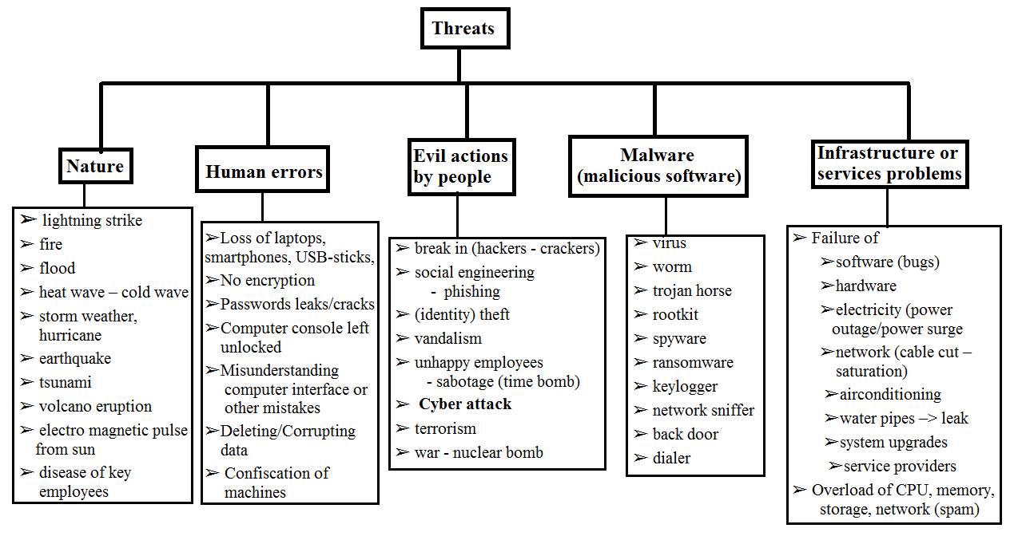
Categories of Computer Security Threats
What can go wrong?

Slide 15
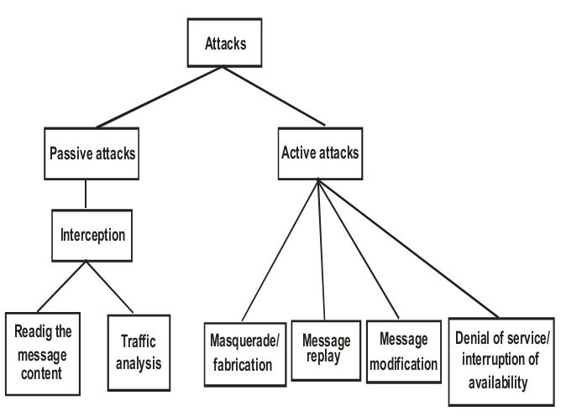
Common Security Attacks
Security Attacks:- Any action that compromises the security of information/resource owned by an organization.
Security attacks are classified as either passive or active attacks.
Fig 1.1 Types of Common Security Attacks

Slide 16
(I) Passive Attacks
A type of attacks which do not change or modify the information flowing between the parties.
attempts to learn or make use of information from the system but does not affect system resources.
goal of learning as much confidential information as possible.
very difficult to detect, b/c they don’t involve any alteration of the data and message is sent and received in an apparently normal fashion.
neither the sender nor receiver is aware that a third party has read msg.
This type of attack include
    Eavesdropping - unauthorized reading of a message of file
    Traffic analysis.

Slide 17
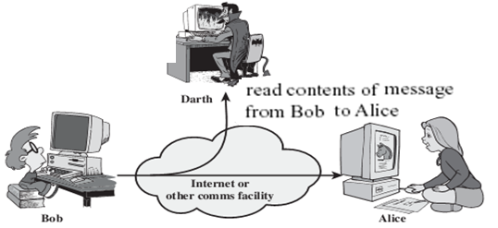
Cont...
Eavesdropping (to listen secretly to what other people saying):
  Also called release of message contents.
  The unauthorized capture of transmitted data/confidential information (telephone conversation, an electronic mail message, and a transferred file) either by some form of line tapping or from the compromising emanations broadcast by the electrical signals in the line.
  Radio, optical and microwave signals can be similarly intercepted covertly
Example:
Wiretapping to capture data in a network
Illicit copying of files or programs

Slide 18
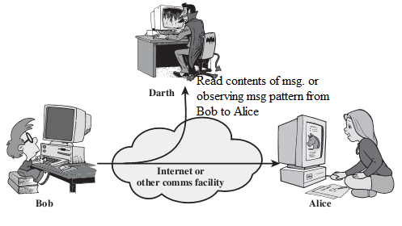
Cont...
Traffic Analysis:
  The purpose of this attack is to determine who is talking to whom by analyzing IP packets/header.
  Even if the payload of the IP packet is masked (encrypted), the attacker may still obtain useful information from analyzing IP headers.
  be able to observe the pattern of these messages (number, size, frequency, time of message sent, length of messages being exchanged) and the opponent could determine the location and identity of communicating hosts.
  This information might be useful in guessing the nature of the communication that was taking place.

Slide 19
(II) Active Attacks
A types of attacks which attempt to alter system resources or affect their operation this includes Masquerade, Message replay, Modification of messages or files, Denial of service.
Are easier to detect since the information stream is altered and involves the other party.
Harder to prevent since no absolute protection is available with the current buggy systems.
Involves some modification of the data stream or creation of a false stream.
Tries to fool the parties to believe they are talking to each other directly, while they really are talking to the attacker him-selves.

Slide 20
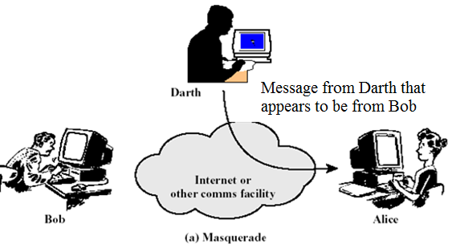
Cont...
Masquerade:
  This attack is possible by the user who will be pretending like a legitimate user and attack the system.
  Example:- any employee is sending the message to the working staff members by taking the name of his manager. He can send the message for conducting meetings in a particular time with his employee, which is actually a forged message.
  enabling an authorized entity with few privileges to obtain extra privileges by impersonating an entity that has those privileges.

Slide 21
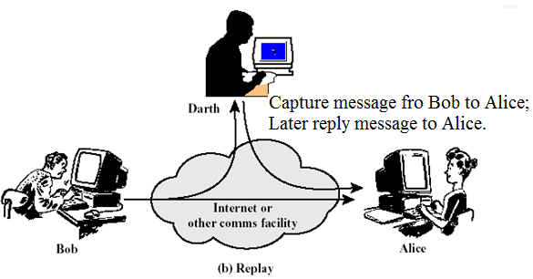
Cont...
Message Reply
  Can take place by sending the same message twice.
  Involves the passive capture of a data unit and its subsequent retransmission to produce an authorized effect.
  Passive capture of data, alter and then retransmit.
  Example:- User A sends a message stating that transfer Birr.10, 000 from Account A to Account B. This message is watched by an other user C and the same message is sent once again by user C on behalf of A. In that scenario, Birr.20, 000 will be debited from account A instead of Birr.10, 000, without his notification. This transaction will create an integrity problem.

Slide 22
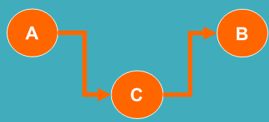
Cont...
Modification of message
  An unauthorized party gains access to information and also modifies it.
  This is an attack on integrity of information.
  Some portion of a legitimate message is altered, or that messages are delayed or reordered, to produce an unauthorized effect or contain different information.
    Corrupting transmitted data or tampering with it before it reaches its destination
  E.g., a message “Allow John to read confidential file accounts” is modified as “Allow Brown to read confidential file accounts.”
Changing values in a data file
Altering a program so that it performs differently
Modifying the content of messages

Slide 23
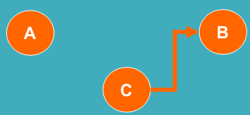
Cont...
Fabrication of message
  An unauthorized party injects fabricated information into the system.
    That is, Faking data as if it were created by a legitimate and authentic party
  This is an attack on authenticity.
  Examples of this is
      insertion of spurious messages,
      addition of records to a file etc.

Slide 24
Cutting of a communication line
Destruction of hardware
Disabling file management system
Cont...
Denial of service (DoS)
  an attempt to make a computer resource unavailable to its intended users and can be launched in many ways.
  Such attacks often force the target computer to process a large number of useless things, hoping to consume all its critical resources.
  Another form of service denial is the disruption of an entire network, either by disabling the network or by overloading it with messages so as to degrade performance
  In general terms, DoS attacks are implemented by either forcing the targeted computer(s) to reset, or consume its resources so that it can no longer provide its intended service or obstructing the communication media between the intended users and the victim so that they can no longer communicate adequately.

Slide 25
Cont...
An asset of the system becomes lost, unavailable, or unusable
How DoS attacks implemented
    Installing malicious software
    Spam Mail
Various other forms of DoS attack is given below
    Buffer Overflow Attacks
    SYN Attack and Smurf Attack
    Teardrop Attack
It is not easy to detect a DoS attack because there is nothing apparent to suggest that a user is launching a DOS attack, and is actually not a legal user of the system.
In a DoS attack it is up to the server to detect that certain packets are from an attacker, and not from a legitimate user to take an appropriate action.

Slide 26
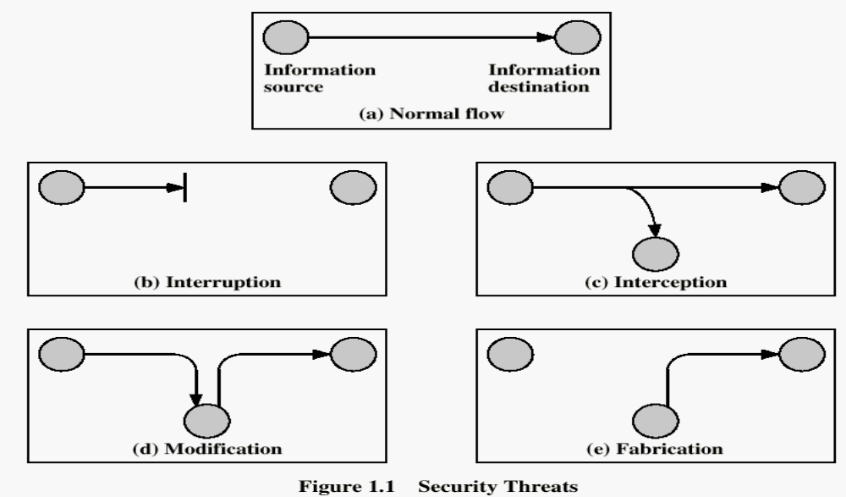
Cont...
In general security Attacks is an assault on system security- an intelligent act that is a deliberate attempt to evade security services and violate the security policy of a system.

Slide 27
Other security attacks
Cryptanalysis
Password Pilfering
Identity Spoofing
    (man-in-the-middle attacks, message replays, network spoofing, and software exploitation attacks)
Repudiation
Intrusion
Malicious Software

Slide 28
1.3 Levels of practical side attacks
Application Level Attacks
  happen at an application level in the sends that the attacker attempts to access, modify or prevent access to information of a particular application, or the application itself.
  Example:- trying to obtain someone's credit card info on the Internet, or' changing contents of a msg. to change the amount in a transaction, etc.
Network Level Attacks
  Aims at reducing capabilities of network by a number of possible means,
  Generally make an attempt to either slow down, or completely bring to halt, a computer network.
  automatically can lead to application level attacks, because once someone is able to gain access to a network, he/she is able to access/modify at least some sensitive information.

Slide 29
Cont…
Cookies Attack
  A typical application is likely to involve a number of interactions between the client and the server, there must be some mechanism for the client to identify itself to the server each time it sends a HTIP request to the server.
  For this, cookies are used.
  A cookie is just one or more pieces of information stored as text strings in a text file on the disk of the client computer i.e. Web browser.
  These attacks take two main forms: packet sniffing and packet spoofing
Packet sniffing/IP Sniffing
  An attacker need not hijack a conversation, but instead, can simply observe i.e. sniff packets as they pass by
Packet spoofing/IP Spoofing.
  Attacker sends packets with an incorrect source address. When this happens, receiver containing false source address would inadvertently send replies back.

Slide 30
Attacker profiles
Attackers are often characterized as
    Hackers
        Black-HatHackers
        White-HatHackers
        Grey-Hat Hackers
    Script kiddies
    Cyber spies
    Vicious employees
    Cyber terrorists
    Hypothetical Attackers

Slide 31
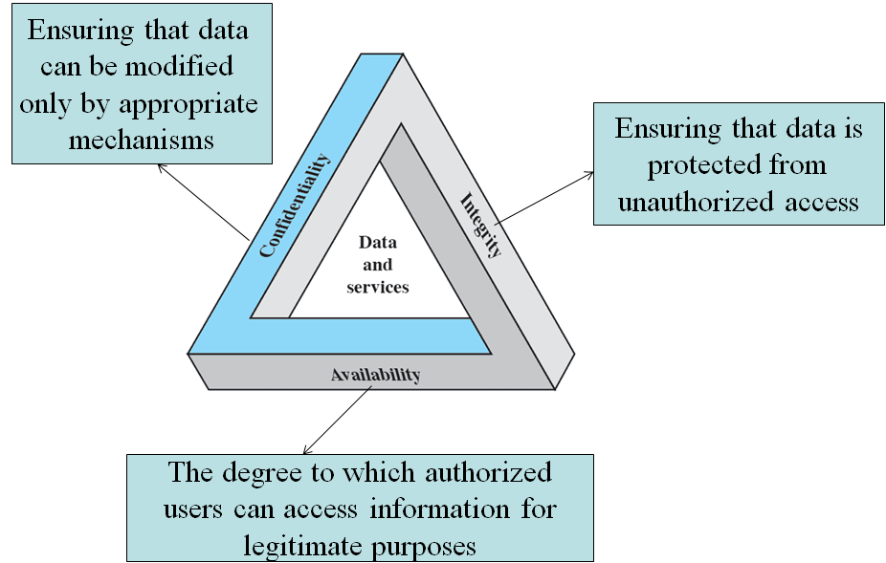
1.4 Security Goals
Additional Concepts
    Authenticity
    Accountability
Figure : CIA Triad of Information Security

Slide 32
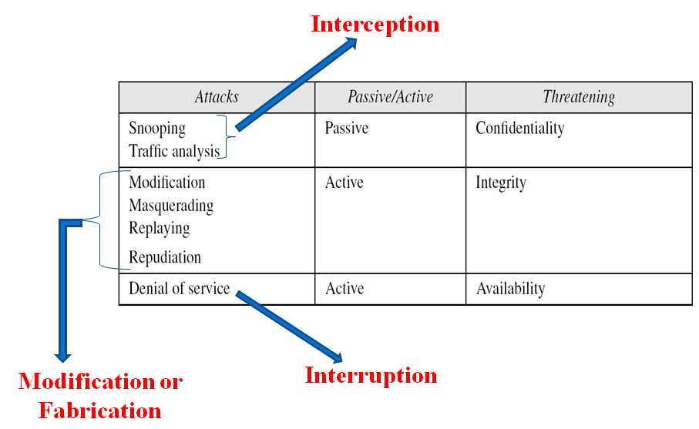

Slide 33
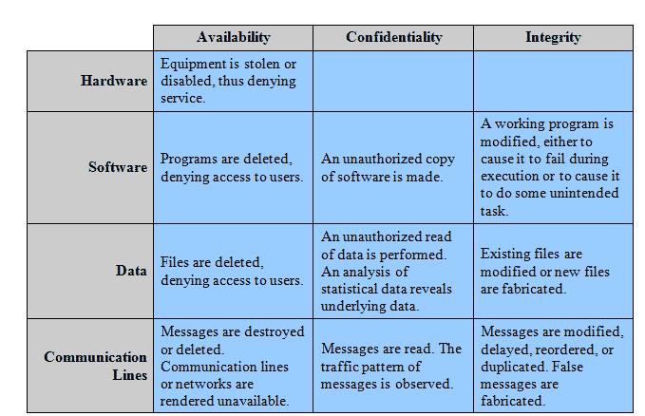
Assets Vs. Security Goals

Slide 34
1.6 Security Service/principles
A security service is the collection of mechanisms, procedures and other controls that are implemented to help in reducing the risk associated with threat.
  For example, the identification and authentication service helps reduce the risk of the unauthorized user threat.
Some services provide protection from threats, while other services provide for detection of the threat occurrence.
  An example of this would be a logging or monitoring service.
In general it is a processing or communication service that is provided by a system to give a specific kind of protection to system resources.
Enhances the security of the data processing systems and the information transfers of an organization.

Slide 35
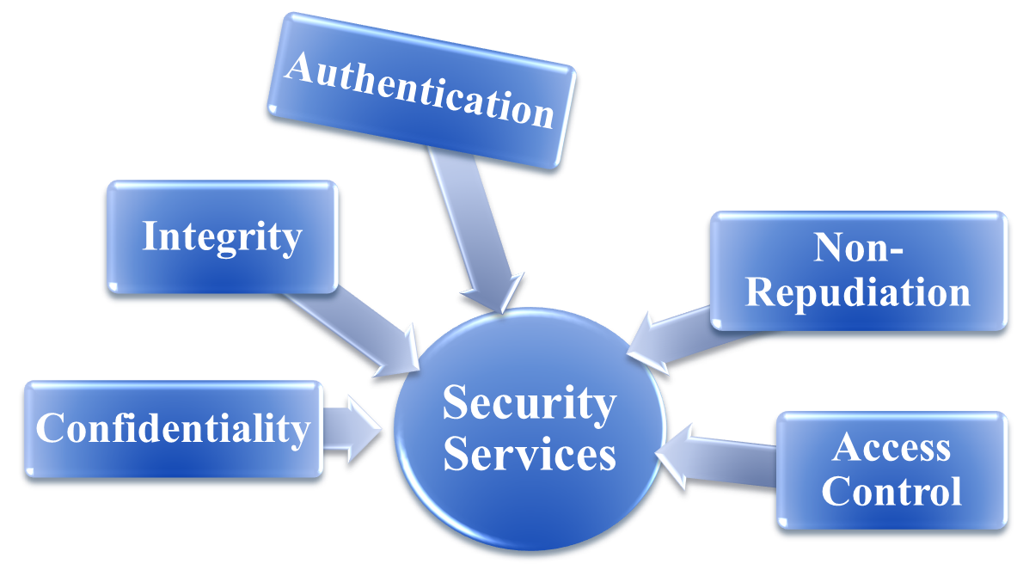


Cont...
A single security services may need to be implemented by multiple and different security mechanisms.
The common types of security services are shown on figure below:
Primary Services

Slide 36
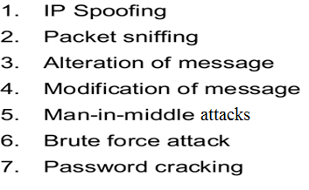
(1) Data Confidentiality (privacy of message)
Protection of data/information from disclosure to unauthorized entities such as organizations, people, machines and processes.
Specially concerned with the protection of transmitted data from passive attacks and traffic flow from analysis.
Information includes data contents, size, existence, communication characteristics, etc.
      Threats can be in the area of network (dangerous b/c online business transaction) or in the area of application (can be created by insider user with full access to system and easily detectable and avoidable)

Slide 37
Cont...
Protection Mechanisms
  Data Encryption
    Symmetric (Secret-Key)
    Asymmetric (Public-Key)
Service Types
  Data Confidentiality / Disclosure Protection
    Connection Oriented - protection of all data on connection(TCP)
    Connectionless - protection all data in a single data block
    Selective Field - protection of a single message or even specific fields within a message.
  Traffic Flow Confidentiality
      Origin Destination Association
      Message Size and Transmission Patterns
  Accompanied with Data Integrity

Slide 38
(2) Data Integrity (has not been altered)
Ensures that the messages are received with no duplication, insertion, modification, reordering or replays.
Protection of data against creation, alteration, deletion, duplication, re-ordering by unauthorized entities (organizations, people, machines, processes).
  Assurance that data received is as sent by an authorized entity
Integrity violation is always caused by active attacks.
Service Types
  Message Integrity
      Associated with
      connectionless comm.
  Message Stream Integrity
      Associated with
      connection oriented comm.
Protection Mechanisms
    Message Digests (Hashing)
    Sequence Numbers
    Nonce ID (Random Number)
    Time Stamps

Slide 39
Cont...
Connection-oriented Integrity:
    Deals with a stream of messages or assure message delivery without alteration and Recovery of destructed or altered data
    Addresses both message stream modification and denial of service
    Connection Integrity with Recovery
        Provides for the integrity of all user data on a connection and detects any modification, insertion, deletion, or replay of any data within an entire data sequence, with recovery attempted.
    Connection Integrity without Recovery
        Provides only detection and reporting without recovery and recovery done by other service or human intervention.
    Selective-Field Connection Integrity
        Provides for the integrity of selected fields within the user data of a data block transferred over a connection

Slide 40
Cont...
Connectionless Integrity:
    Deals with individual messages and provides protection against message modification only.
        This is because it only deals with individual packets.
    Connectionless Integrity
        Provides for the integrity of a single connectionless data block and may take the form of detection of data modification.
    Selective-Field Connectionless Integrity
        Provides for the integrity of selected fields within a single connectionless data block.

Slide 41
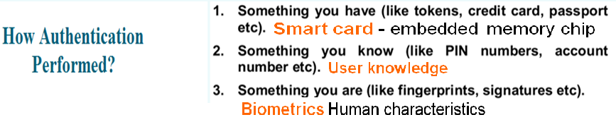
(3) Authentication
Is the assurance that the communicating entity is the one that it claims to be (specially the source of the msg i.e. origin verification).
Communicating entities are provided with assurance & information of relevant identities of communicating partners (people, machines, processes).
Personnel Authentication requires special attention.
In connection of a terminal to a host, two aspect is involved
    1st During connection initiation – two entities are authentic
    2nd Services assure that the connection is not interfered by 3rd party

Slide 42
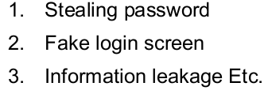

Cont...
Peer Entity Authentication:
    used in association with a logical connection to provide confidence in identity of the entities.
    involves implementation of same protocol
Data Origin Authentication:
    In a connectionless transfer, it provides assurance that the source of received data is as claimed.
    Does not involve data protection against attacks
Protection Mechanism
    Data encryption
    Password (Manual or One-Time Password)
    Key Sharing (Manual, Symmetric Key or Asymmetric Key)
    Challenge–Response (Nonce Based or Zero Knowledge Proof)

Slide 43
(4) Access Control (Read, Write, Read/Write, Owner)
This service controls
    Who can have access to a resource,
    Under what conditions access can occur and
    What those accessing the resources are allowed to do.
Protection of information resources or services from access or use by unauthorized entities (organizations, people, machines, processes).
    Privileges – rights to access or use resources or services
    Principles – entities own access control privileges
    Subjects – entities exercise access control privileges
    Objects / Targets – resources or services accessed/used by subjects
    Delegation – transfer of access control privileges among principals
    Authorization – transfer of access control privileges from principals to subjects

Slide 44
Cont...
Protection Mechanisms
  Access Control Lists (ACLs)
    Object Based Specification
    Ex.: UNIX File System
  Capabilities
    Subject Based Specification
    Issue Tickets/Certificates
Service Types
  Subject Based Typing
    Identity Based
    Role Based
  Enforcement Based Typing
    Mandatory Access Control ― Management Directed
    Discretionary Access Control ― Resource Owner Directed

Slide 45
(5) Non-Repudiation
Prevents either sender or receiver from denying a service
Provides protection against denial by one of the entities involved in a communication of having participated in all or part of the communication.
Service Types
  Non-Repudiation of Origin
  Non-Repudiation of Reception
Protection Mechanisms
  Notarization
  Time Stamp
  Digital Signature

Slide 46
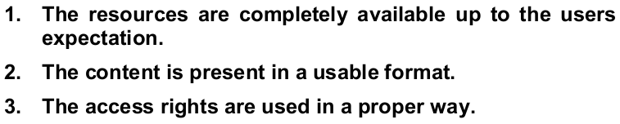
(6) Availability
Defined as keeping the right information or resources available to the right person at the right time (i.e. system resource being accessible and usable upon demand by an authorized system entity)
Will stop the person from accessing various resources by flooding the network.
A variety of attacks can result in the loss of or reduction in availability. Mainly DoS attack.
Some attacks are amenable to automated countermeasures, such as authentication and encryption, whereas others require some sort of physical action
Identified as issue only when the following conditions are existing.

Slide 47
(7) Audit
Recording & analyses of participation, roles and actions in information communication by relevant entities.
Service Types
  Off-line Analysis (Computer Forensic)
  On-line Analysis (Real-time Intrusion Detection)
Protection Mechanisms
  Intrusion Monitors / Sensors
    Common Intrusion Detection Framework (CIDF)
    Common Information Model (CIM)

Slide 48
Summary o Security Services
Confidentiality ------- (privacy)
Authentication -------- (who created or sent the data)
Integrity -------- (has not been altered)
Non-repudiation --------- (the order is final)
Access control --------- (prevent misuse of resources)
Availability ---------- (permanence, non-erasure)
      Denial of Service Attacks
      Virus that deletes files

Slide 49
(II) Pervasive Security Mechanisms
Mechanisms that are not specific to any particular OSI security service or protocol layer
Trusted Functionality - That which is perceived to be correct with respect to some criteria (e.g., as established by a security policy).
Security Label - The marking bound to a resource (which may be a data unit) that names or designates the security attributes of that resource
Security Audit Trail - Data collected and potentially used to facilitate a security audit, which is an independent review and examination of system records and activities.
Event Detection:- Detection of security-relevant events.
Security Recovery:- Deals with requests from mechanisms, such as event handling and management functions, and takes recovery action

Slide 50
THE END
???

Slide 51
Computer Security Challenges
Computer Security is both fascinating and complex:
    not simple
    must consider potential attacks
    procedures used counter-intuitive
    involve algorithms and secret information
    must decide where to deploy mechanisms
    battle of wits between attacker/administrator
    not perceived to be a benefit until fails
    requires regular monitoring
    too often an after-thought
    regarded as impediment to efficient and user friendly use of system

